Slide 1
SGEMM
Characterization
on NVIDIA GPUs
using Profiling Metrics
for Autonomous Driving

Slide 2
Outline
Abstract
Introduction
Motivation and Related Work (Nuren)
Methodology
Experimental Result (Yerkebulan)

Slide 3
Abstact
In this paper we discuss about better designing methods of SGEMM (single-precision general matrix multiplication) in terms of memory and thread-block hierarchy on NVIDIA GPUs. This paper is focused on extracting important metrics using command-line, light-weight, GUI-less profiler called Nvprof which were used to explain why different designs of SGEMM algorithm results in different GPU performance. NVIDIA Tesla T4 based on latest Turing architecture with Compute Unified Data Architecture (CUDA) version 11.1 and NVIDIA GeForce GTX 1050 Max-Q design with CUDA version 10.1 were used to test and compare different designing methods.

Slide 4
Focus of our research
Find and classify most important parameters in tuning GEMM algorithms for different GPUs using profiling metrics
Show effect and reason of choosing those metrics
Discuss how these metrics can explain why some SGEMM algorithm designs perform better than others.
Compare our algorithm with CuBLAS SGEMM algorithm using those metrics

Slide 5
Motivation
Exponential data growth
ML, DL computational effort for training and inference increasing
Main computational time is taken by convolution steps which is basically GEMM operations
Many proposed GEMM algorithms are hardware and task specific
Need to find out most important kernel parameters to look at when moving from one GPU to another using metrics analysis
Profiling metrics will show why some GEMM designs perform better than others and can give hints how to build better algorithms

Slide 6
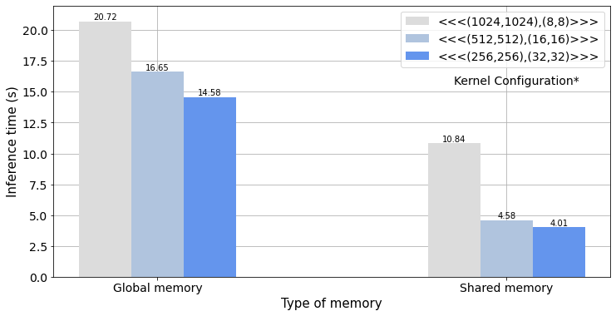
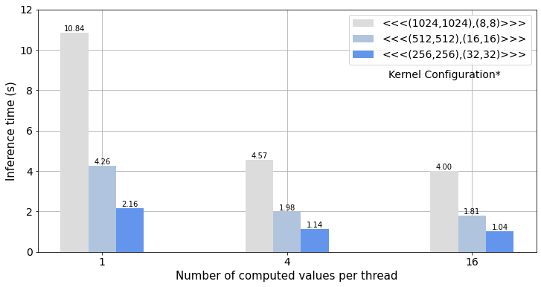
Memory and Thread/Block Optimization
* - <<<Number of blocks per Grid on (x,y) axis, Number of threads per Block on (x,y) axis>>>
Fig. 2. Inference Time of SGEMM (matrix size 8192x8192) algorithm for different number of computed values per thread
Fig. 1. Inference Time of SGEMM (matrix size 8192x8192) algorithm with different memory and thread/block optimizations

Slide 7
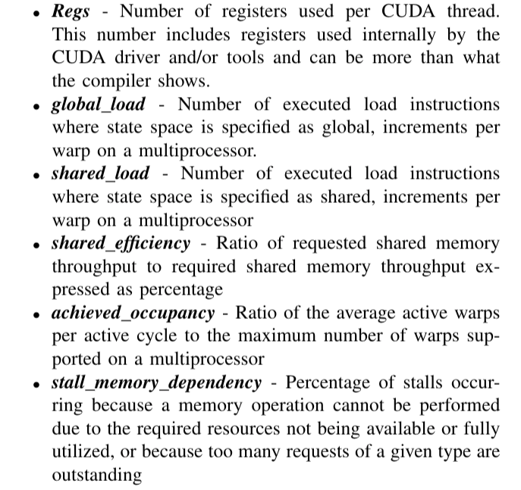
Chosen profiling metrics

Slide 8
What we did?
Fixed one of the parameters and by varying others chose the best
1. Started with different thread/block sizes and different methods
8x8, 16x16 (best), 32x32 thread block
Naive, shared memory, shared + registers (best)
2. Fixed thread/block size on 16x16 and focused on memory part
Register blocking: 4x4, 6x6, 8x8 (best), 10x10, 12x12
Shared sub-array: 64x16, 64x64, 96x16, 128x16, 128x32 (best)
3. Repeated on intermediated values for 3 main parameters:
Thread/block size: 16x8 (best), 32x16
Register blocking: 4x8, 8x16 (best), 10x16, 10x20
Shared sub-array: 128x16, 128x8 (best), 128x32
2 features
2 features

Slide 9
Methodology
Motivational example showed that using shared memory as temporary storage for reusing data significantly reduces execution time. In addition, experiments with shared memory shows 2 significant features of kernel to configure:
Values per thread (register blocking)
Block size dimension (threads per block)
Thus, more broad experiments are conducted on these 2 features.
To explain experimental results, metrics below are used:
stall_memory_dependency
Achieved_occupancy
global_load
shared_load
shared_efficiency
Registers per thread

Slide 10
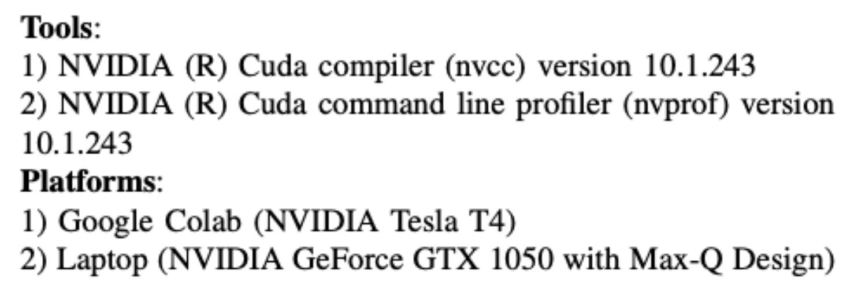
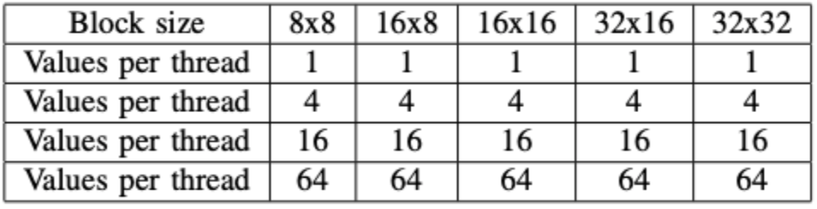
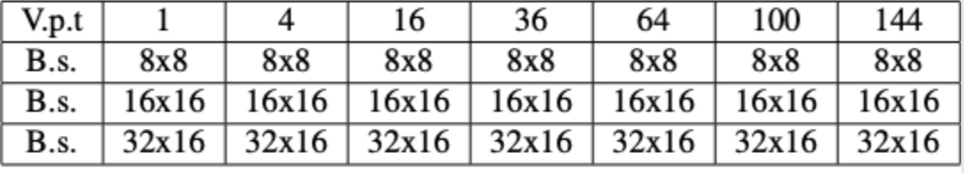
Experimental setup
Experiments on block size and values per thread:

Slide 11
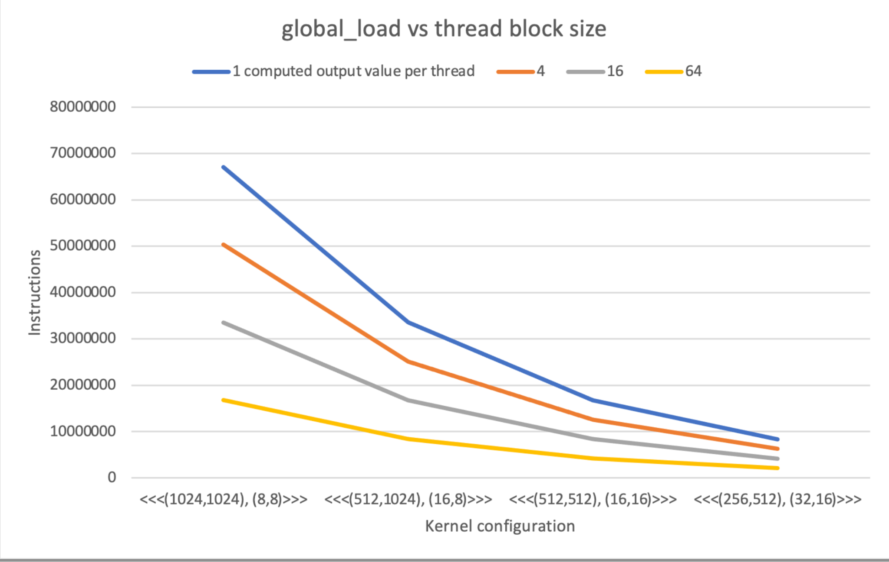
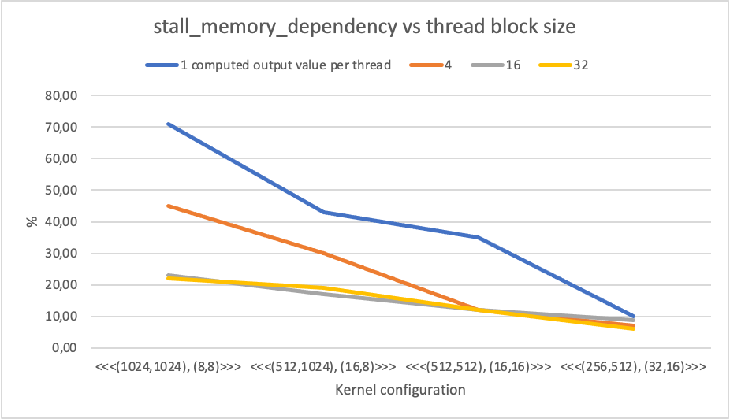
Experimental results
Increasing block size dimension increases block work size which reduces number of accesses to global memory (figure 1)
Thus, warps are less stall on waiting memory operations (figure 2)

Slide 12
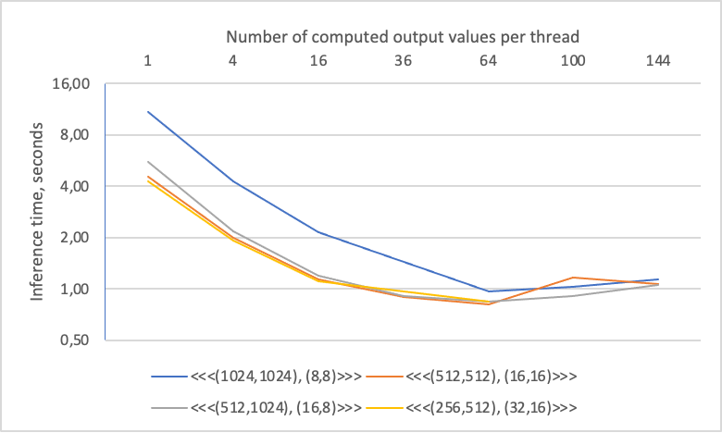
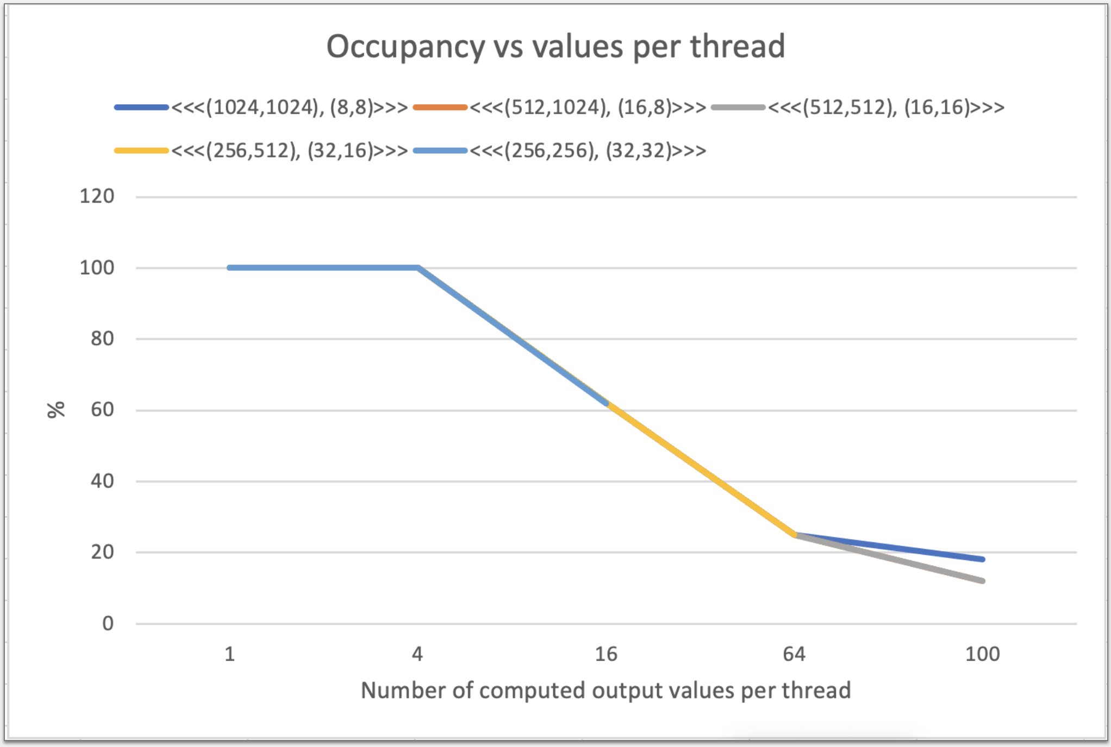
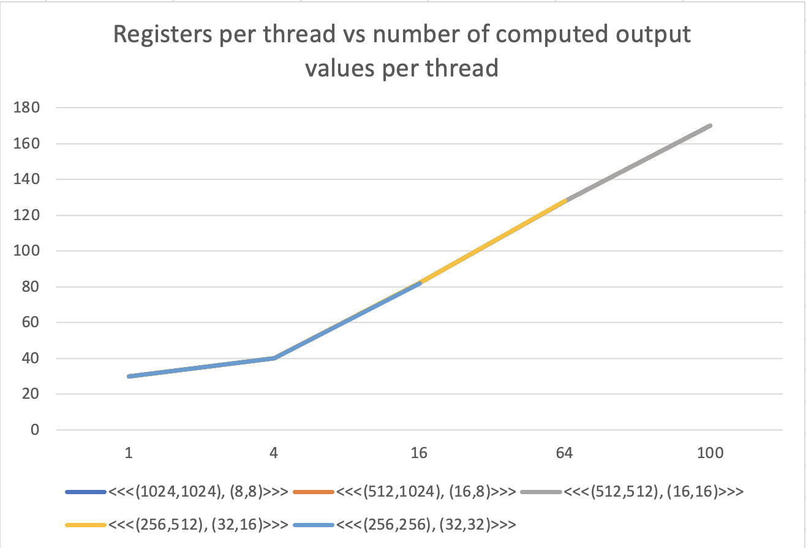
Experimental results
Increasing values per thread gives speed up until some point. Probably, when occupancy level becomes too low (~25%). Occupancy drops because increasing values per thread consumes more registers per thread, reducing number of active warps due to limited register resource.

Slide 13
Comparison with CUBLAS sgemm
 |  | Our best (a) | Cublas (b) | Ratio a/b
Memory hierarchy | global_load | 26.8 * 10^7 | 10.3 * 10^7 | 2.6
 | shared_load | 2.7 * 10^9 | 1.08 * 10^9 | 2.5
 | stall_memory_dependency | 11.62% | 34.49% | 0.34
 | shared_efficiency | 41% | 44% | 0.93
Thread hierarchy | occupancy | 25% | 25% | 1
 | Register per thread | 128 | 122 | 1.05

Slide 14
Conclusion
Using shared memory, definitely more effective than using only global memory (shown in motivational example). In addition, motivational example showed that implementation using shared memory has 2 important features: values per thread, block size dimension. Thus experiments was done to identify how these 2 features are affecting execution time of kernel. Experimental results showed that values per thread is the most significant factor of sgemm kernel. However, we have to care with occupancy, these 2 characteristics have inverse relationship between other, so we concluded that best characteristics of sgemm kernel is finding balance between values per thread and occupancy.

